Slide 1

Pop-In-Solution web design
DevSecOps-Driven IT Solutions Website

Slide 2

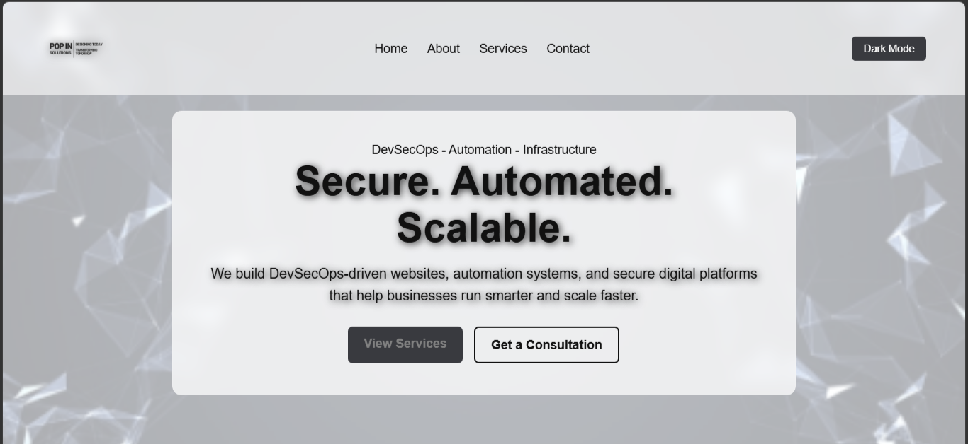
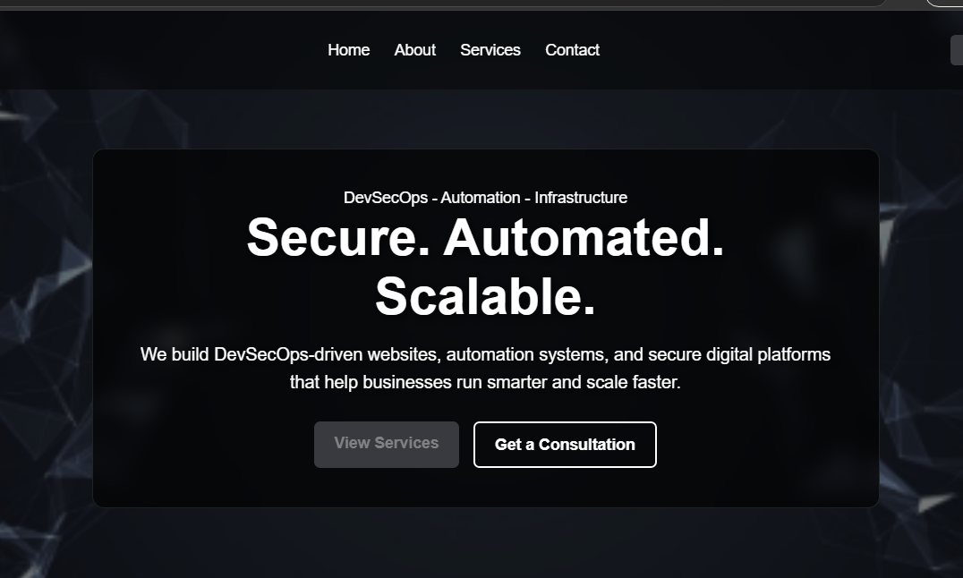
Project Overview
Responsive multi-page website Built for Pop-in-Solutions Modern DevSecOps company branding Focused on user experience and responsiveness

Slide 3
Tools and Technologies
HTML5
Used for website structure
CSS
Used for styling and responsiveness
JavaScript
Used for animations and interactivity

Slide 4
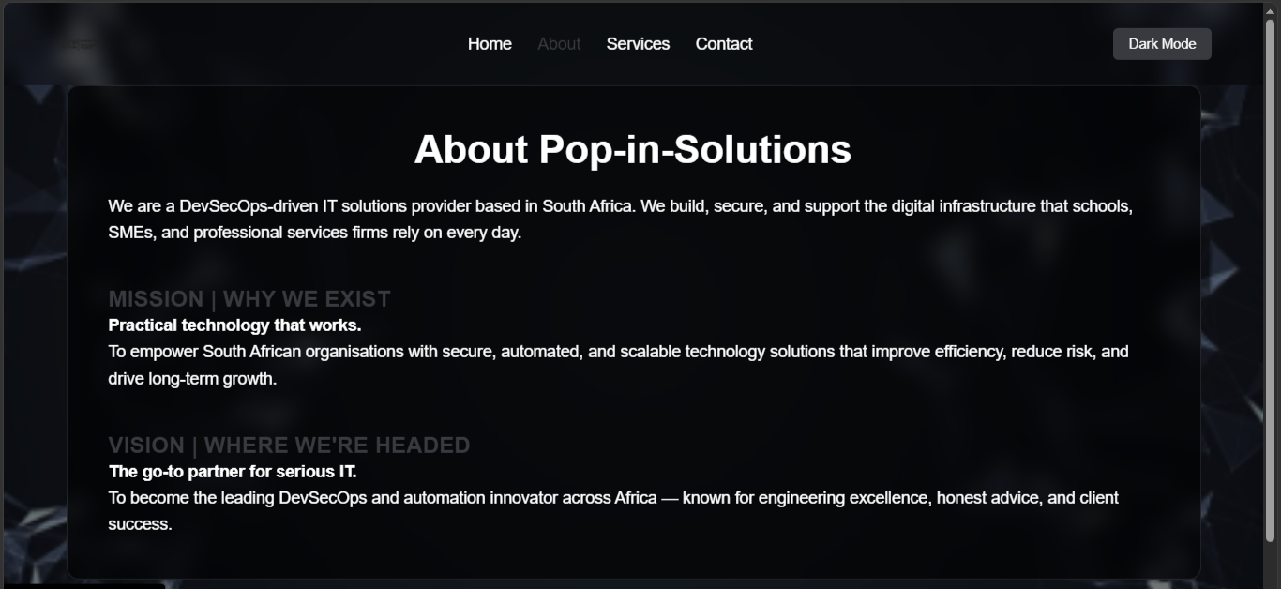

Slide 5
Design and User Experience
The website was designed with a modern and professional aesthetic to reflect the innovative nature of Pop-in-Solutions as a DevSecOps-driven IT solutions provider.
A clean and structured layout was used to ensure that users can easily navigate between pages and access important information without confusion. Consistent spacing, typography, and colour usage were applied throughout the website to create a visually balanced and user-friendly experience.
The colour palette was carefully selected to create a professional technology-focused appearance while maintaining readability and visual contrast. Accent colours were used strategically to highlight important buttons, headings, and interactive elements.
The website was also designed with responsiveness in mind, ensuring that the layout adapts smoothly across desktop, tablet, and mobile devices. Interactive elements and animations were included to create a more engaging browsing experience while maintaining simplicity and ease of use.
Overall, the design approach focused on clarity, accessibility, responsiveness, and professional presentation to provide users with a seamless and intuitive experience.

Slide 6
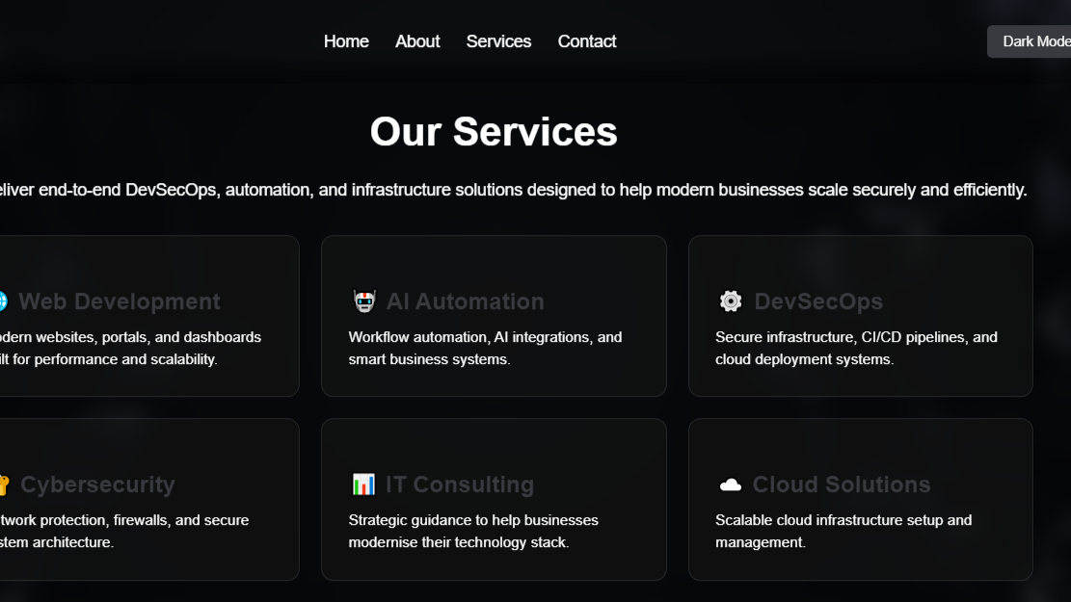

Slide 7
Website Structure
The website was designed using a multi-page structure to organise information clearly and improve navigation.
Home Page: Introduces the company and highlights its main services.
About Page: Explains the company’s background, mission, and vision.
Services Page: Displays the IT solutions and services offered.
Contact Page: Provides contact details and a contact form for users.
A consistent navigation bar was used across all pages to create a simple and user-friendly browsing experience.

Slide 8
FEATURES IMPLEMENTED
Theme toggle
Scroll reveal
Animation
Responsive design
Contact form
Service cards

Slide 9
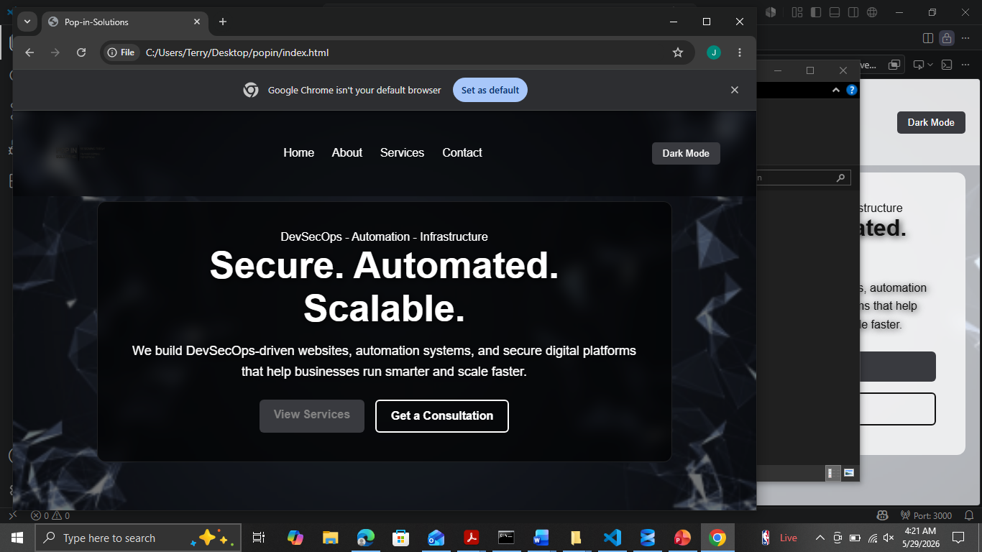
TESTING PERFORMED

Slide 10
CHALLENGES FACED
JavaScript errors - Corrected script structure
1
Mobile responsiveness - Used CSS media queries
2
Logo visibility - Added contrast styling
3

Slide 11
FUTURE IMPROVEMENTS
Backend integration for the contact form
Real social media integration
Fixed dark mode button
User authentication systems
Service booking functionality
Portfolio or project showcase section
Performance optimisation

Slide 12
Contact: Jodinelemena@gmail.com

